Slide 1
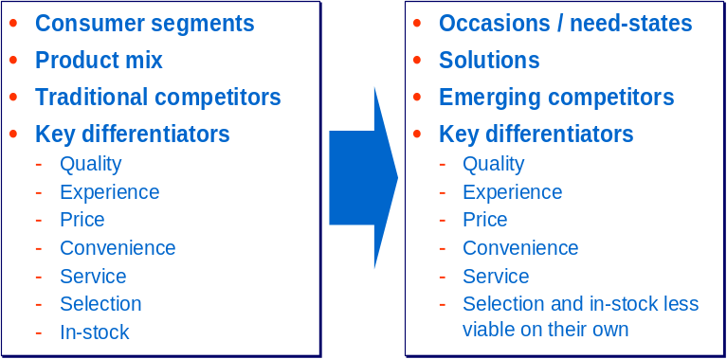
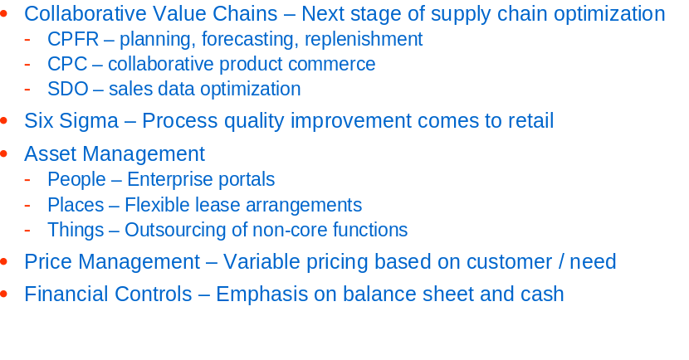
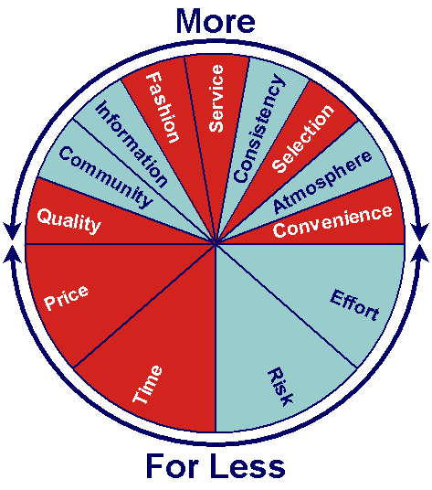
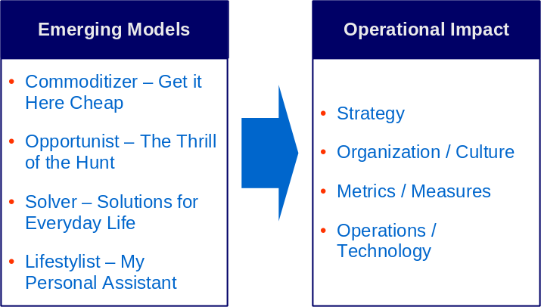
A mixture of “Art” and “Science” is required
Real Focused: Defining Positioning Elements
Real Efficient: Across the Enterprise
Real Smart: Multi-Plex Consumer Value Drivers
Real Close: Business Model Alignment

